Slide 1
Fitness Studio Preference Analysis
Kushal Shah <ks5574@nyu.edu>
Rupesh Bagwe <rpb337@nyu.edu>
Vinayak Natarajan <vn686@nyu.edu>
Guided by: Professor Juan Rodriguez

Slide 2
Problem Statement
Leveraging Fitness Studio Preferences of people to attract growth of newer businesses and promote investments.
The main goal is to generate metric that would help the corporations/franchises to decide marketing/expansion plans.

Slide 3
Problem Statement
Who is it for?
Primarily for entrepreneurs who want to open new Fitness Studios.
Secondarily, for Existing studio owners to plan targeted advertisements.
Also for franchises who plan on expanding to new regions.

Slide 4
Data
Yelp dataset
Business(200k)
Review(2M)
User(500k)

Slide 5
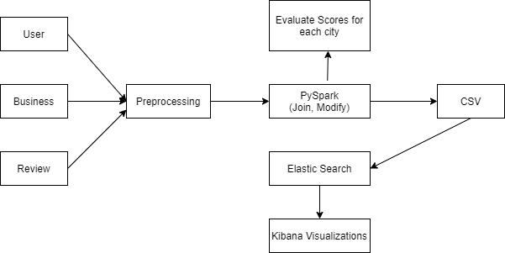
Architecture
Datasets

Slide 6
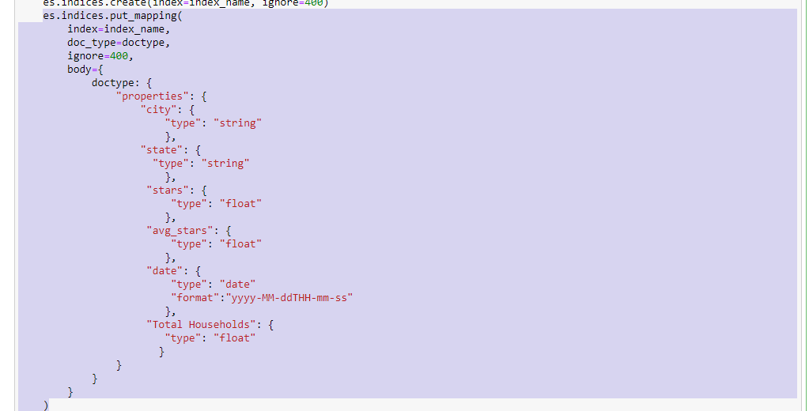
ElasticSearch
Create es mapping to create a document for every row
Insert each document into elasticsearch
Create an es index for data aggregation and visualization

Slide 7
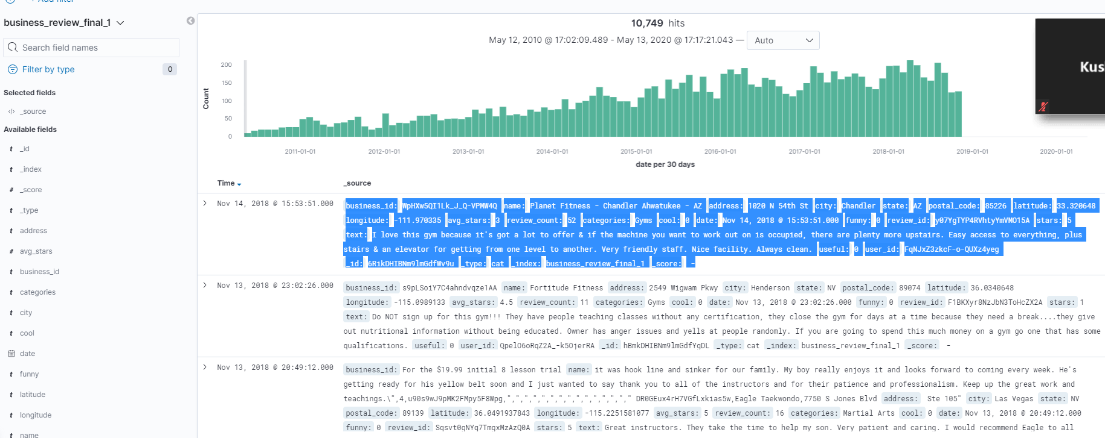
ElasticSearch mapping

Slide 8
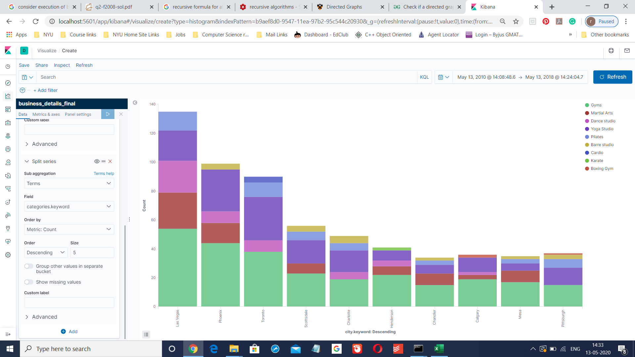
Kibana Visualizations

Slide 9
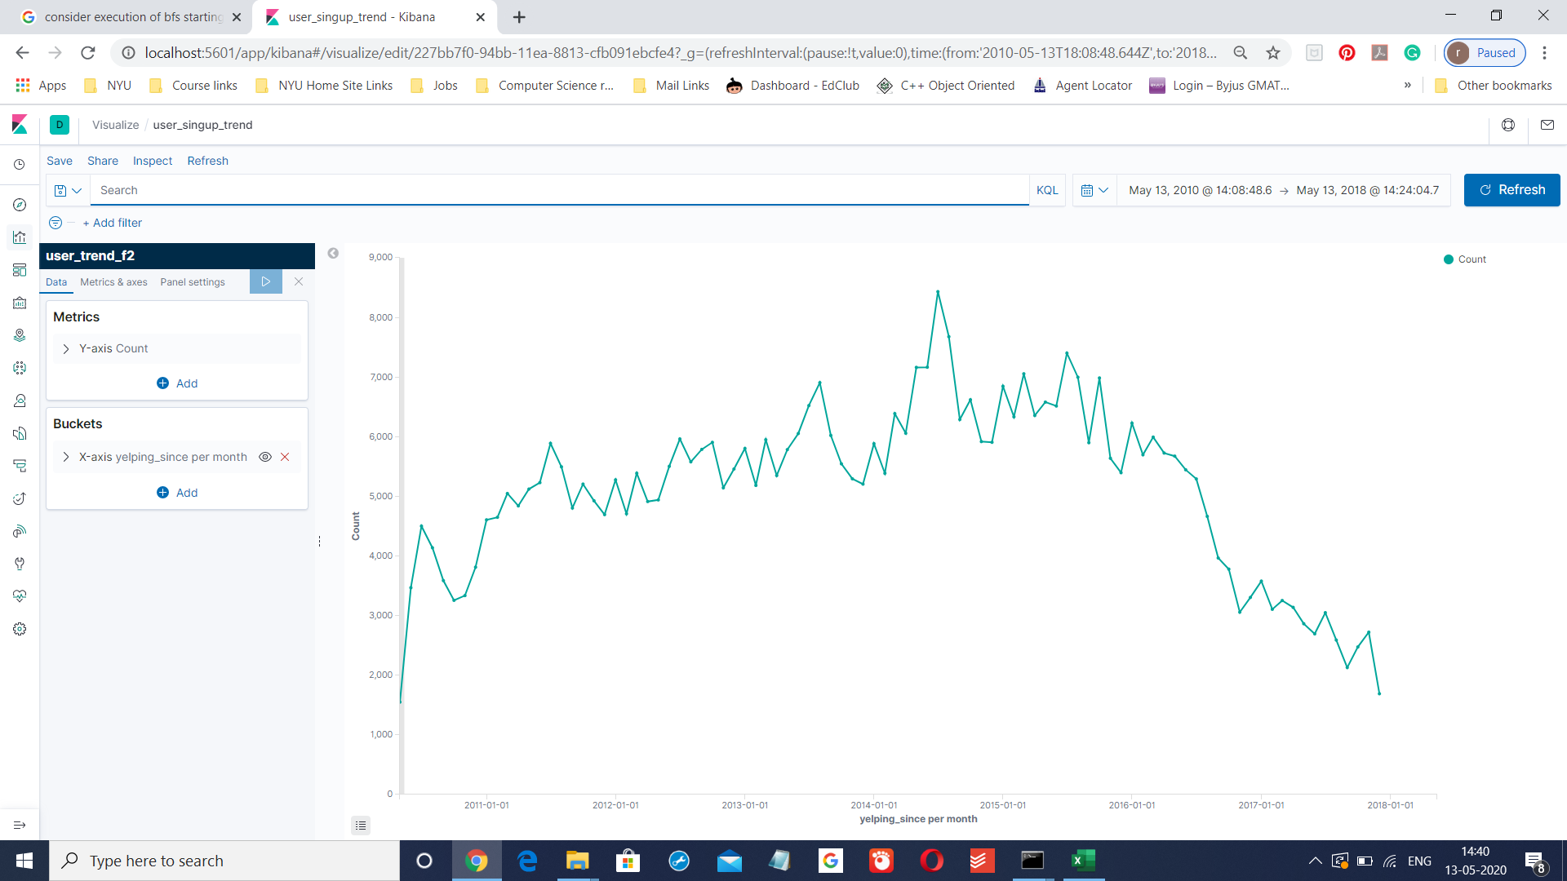
User Signup Trends

Slide 10
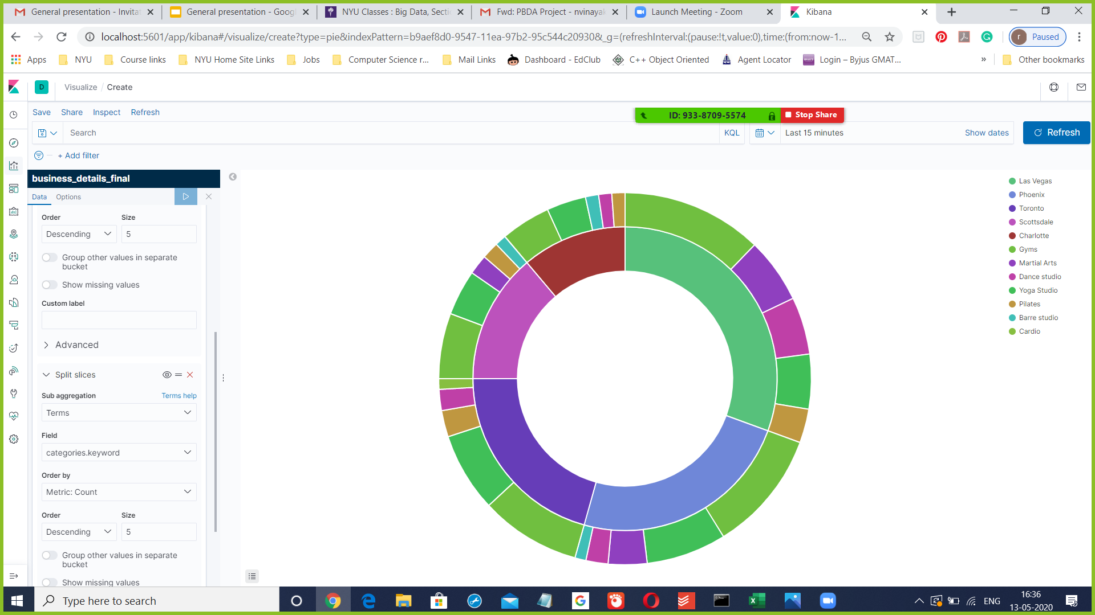
The inner donut represents different cities while the outer donut represents various Fitness Studios. This visualizations gives us a clear idea about how the distribution of the Fitness Studios vary over different cities.

Slide 11
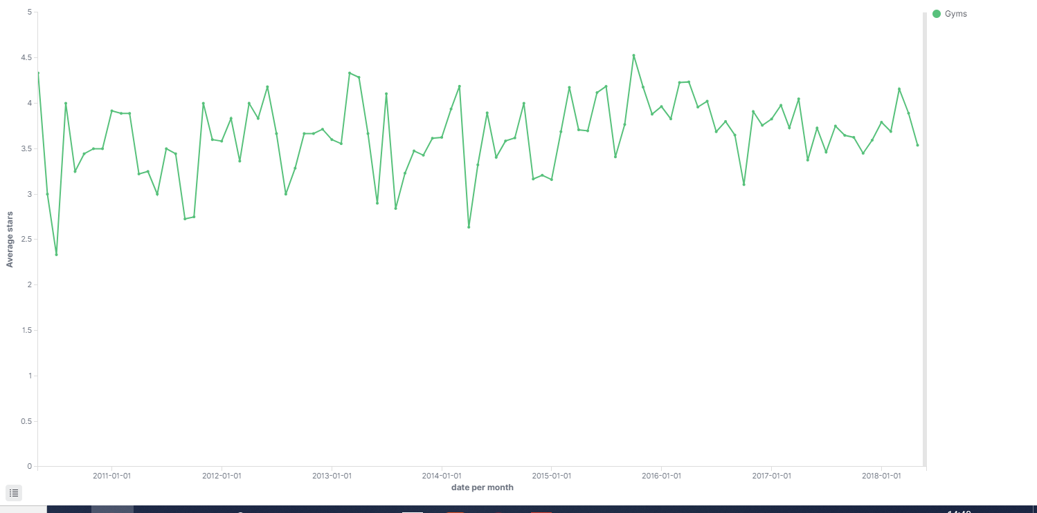
This visualization shows us the trend of the Average ratings of Gyms in Arizona State.

Slide 12
Data Analysis
In Data analysis we considered all the reviews of the customers related to various fitness studios and established a connection between the reviews and fitness studios preferred by the users for a particular city.
Using the analysis we can find which fitness studios are prefered by people of that city. For example People of Phoenix prefered Yoga while people of Tempe prefered Gym.
Also we can find why a studio is not prefered and how we can make it more preferable.

Slide 13
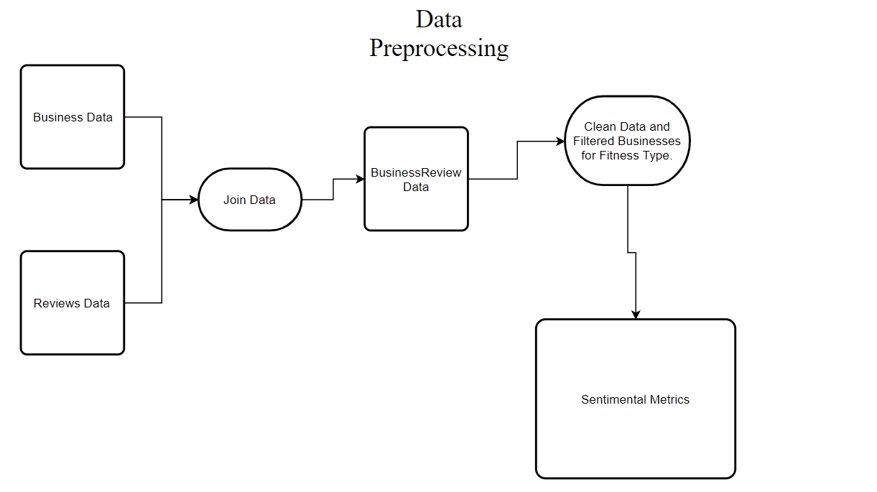

Slide 14
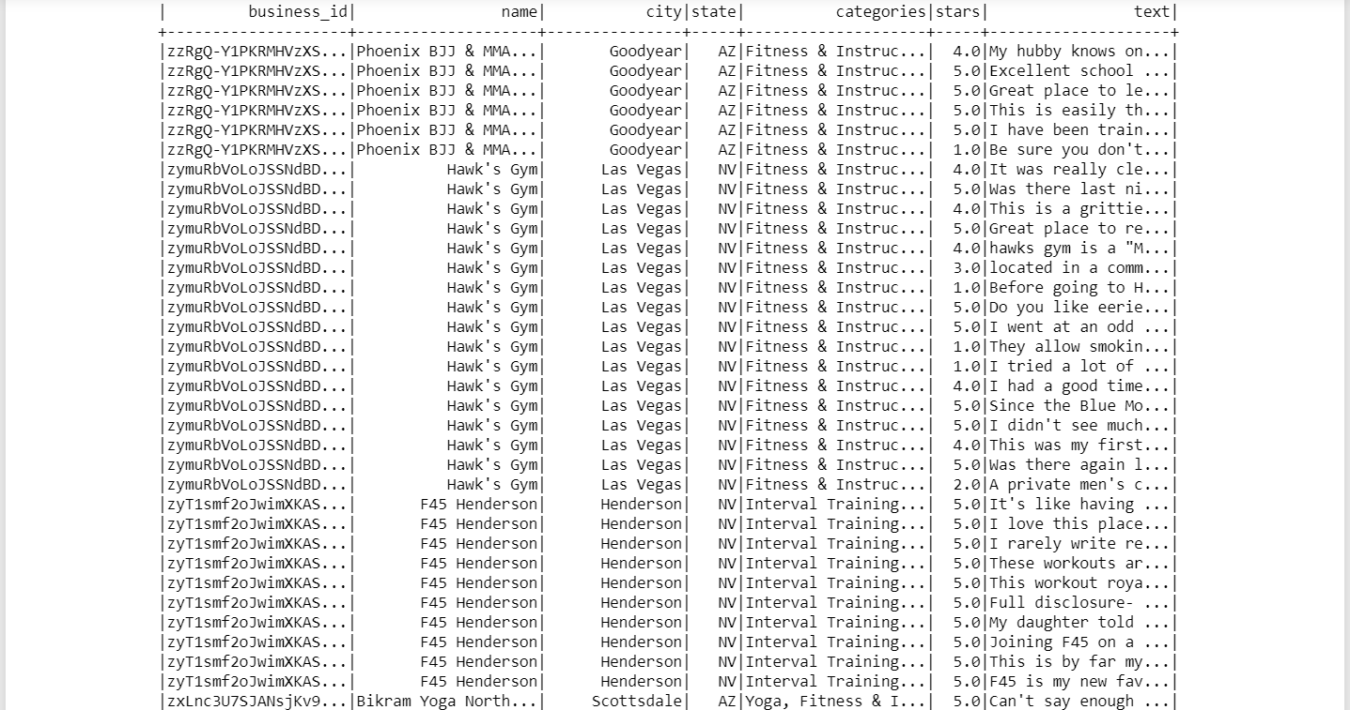
Data After Preprocessing

Slide 15
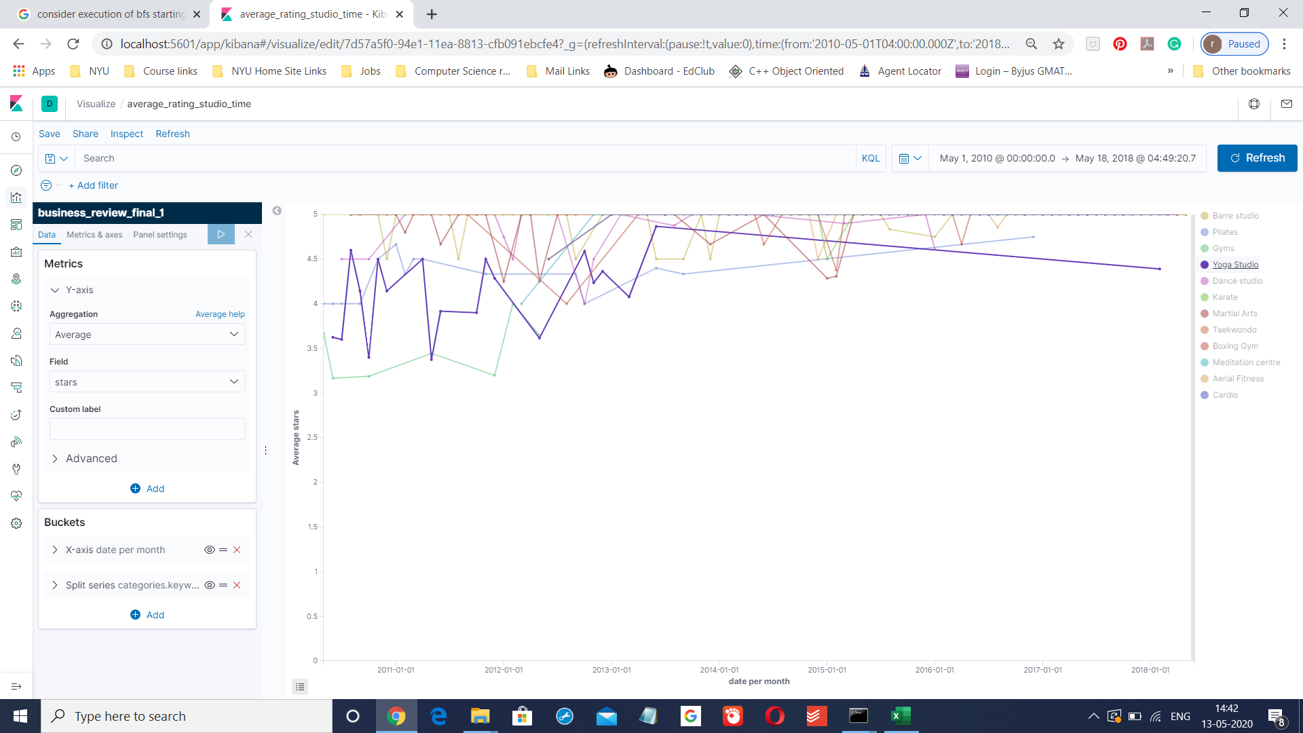
This visualization shows the Average rating received by a specific Fitness Studio. Here each line represents a Fitness Studio. The x-axis has time and y-axis has the average ratings.
As we can see the dataset is more inclined towards positive reviews, we have considered 4,5 ratings as positive review and 1,2,3 as negative reviews.
Also 3 could be considered separately for a standard balanced dataset

Slide 16
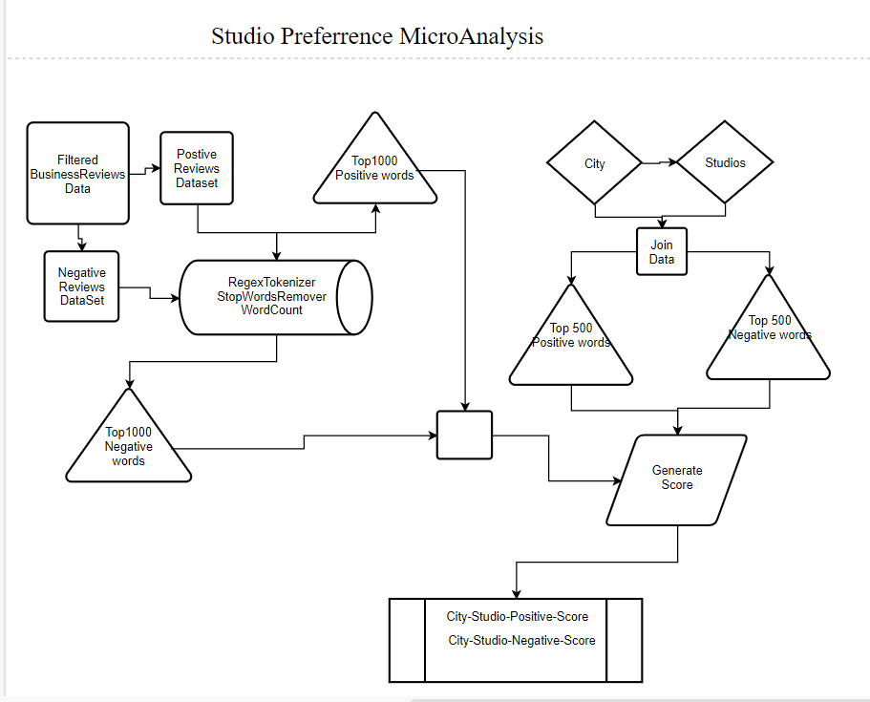

Slide 17
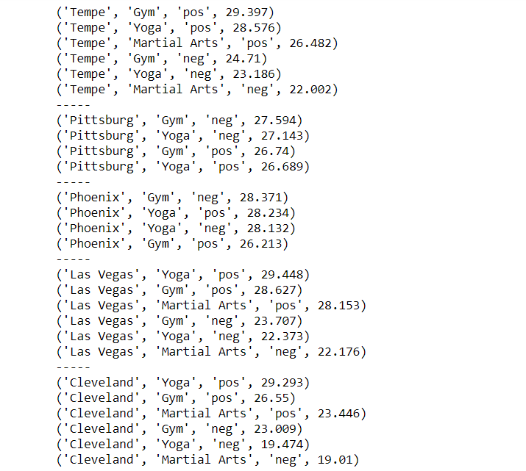
Result:

Slide 18
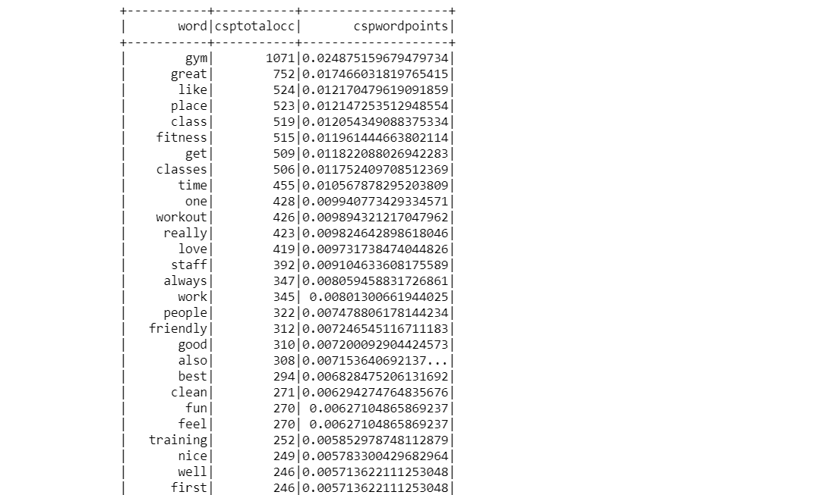
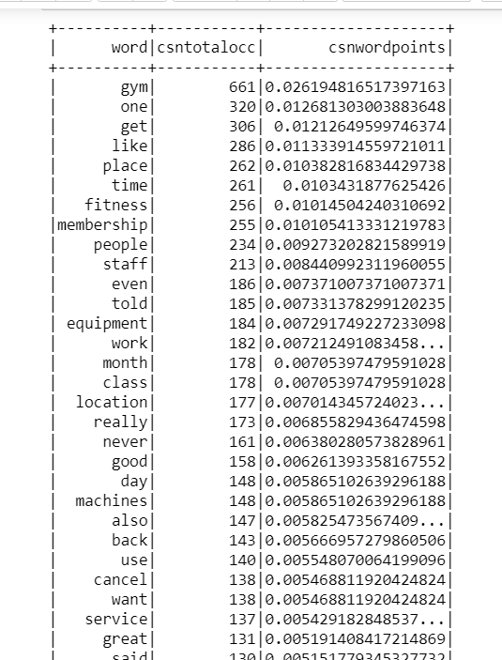
Positive Keywords
Negative Keywords

Slide 19
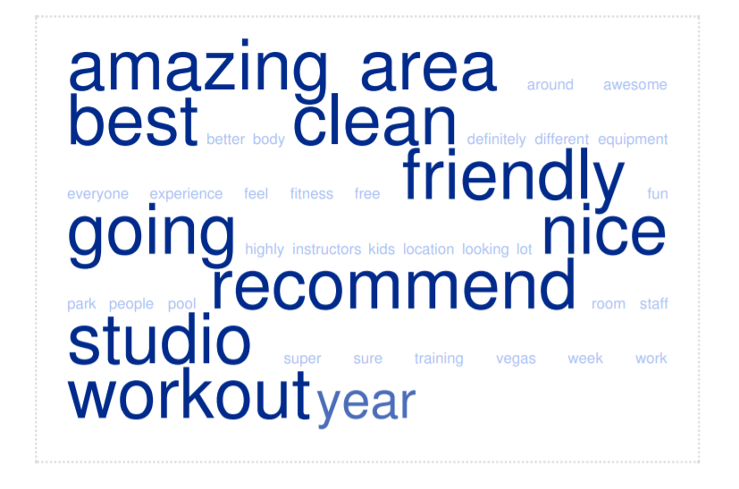
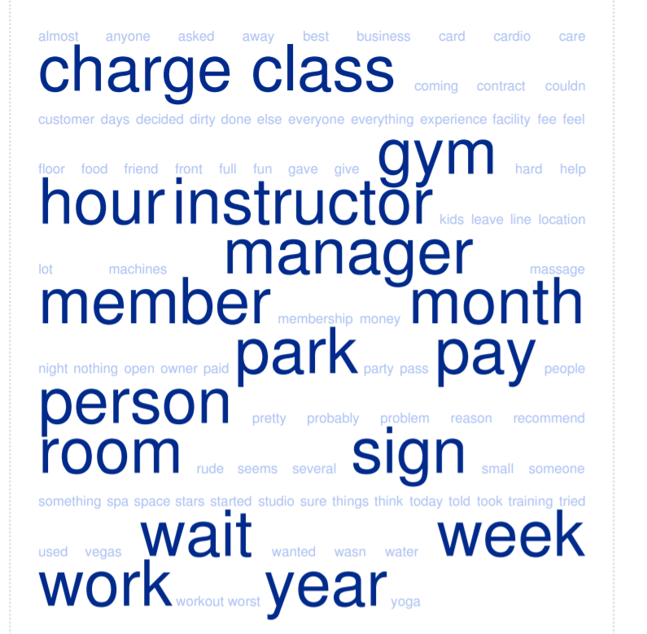
Positive Keywords
Negative Keywords

Slide 20
Scalability in Production Environment
For each city filter business by category Active Life/Fitness Instruction(Upto 200k business, 20M+ reviews).
Create indexes on elasticsearch based on metric to be evaluated
Display both macro and micro level metric on Kibana to derive insight.
We have used only Unigram but the feature will be more robust and useful after we use bigram and trigrams

Slide 21
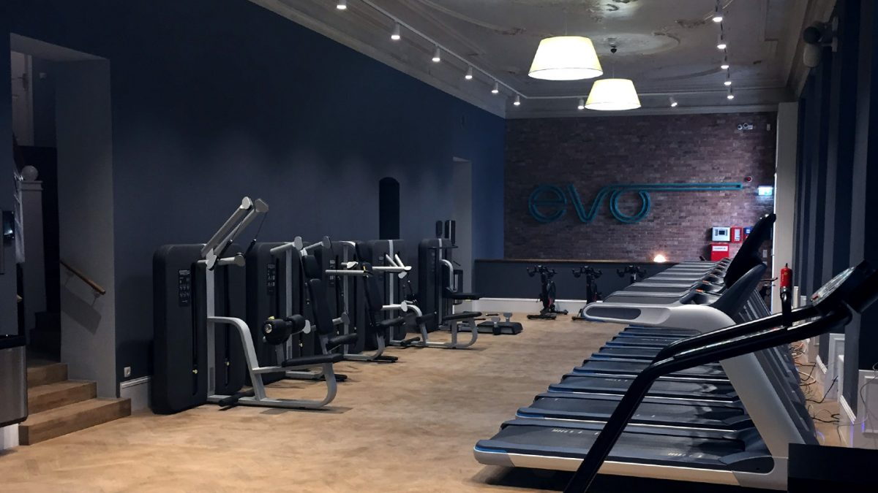

Thanks!

